Slide 1








Consumer Goods Ad-Hoc insights
Presented by : GeethaReddy Asi

Slide 2




1
Primary Goal
2
About Company
3
Data and Tools Required
Agenda
4
Insights
Topics Covered
5
Suggestions

Slide 3




Primary Goal
AtliQ Hardware (Imaginary Company) is one of the leading hardware producers in india and well expanded to other countries too
However, the management noticed that they do not get enough insights to make quick and smart decisions.They want to expand their data anlaytics team by several junior analysts
Tony Sharma, their data analytics director wanted to hire someone who is good at both technical and soft skills. Hence, he decided to conduct a SQL challenge which help him understand both the skills

Slide 4




AtliQ Hardware Products
P & A
PC
N & S
Peripherals
Accessories
Notebook
Desktop
Storage
Network
Internal HDD
Graphic Card
Processors
MotherBoard
Mouse
Keyboard
Batteries
personal Laptop
Gaming Laptop
Personal Desktop
Business Laptop
External Solid State Drives
USB Flash Drivez
Wi fi extender

Slide 5




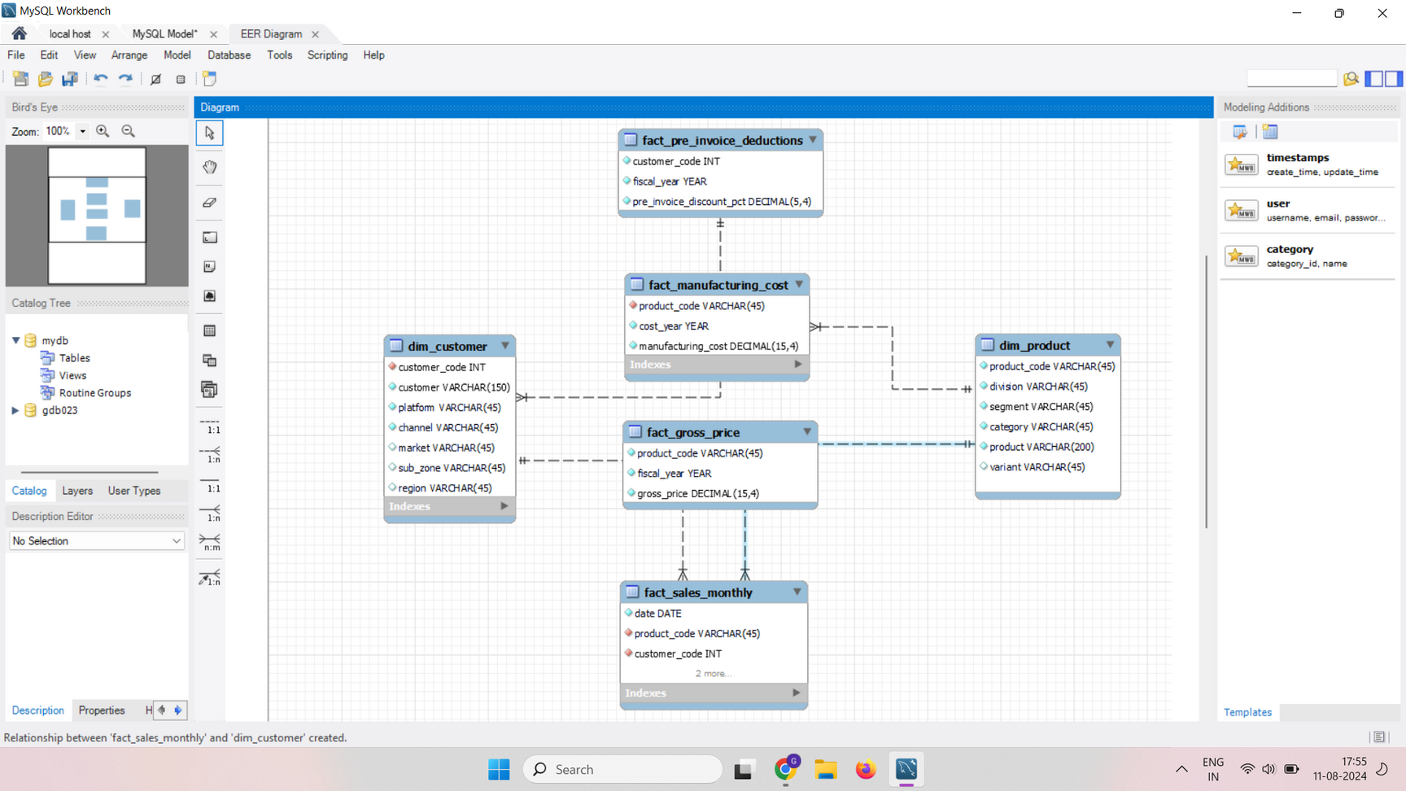

Data and tools required
Data
Input data consists of sales data for the fiscal year 2020 and 2021.
fiscal year of company starts from september

Slide 6


Slide 7
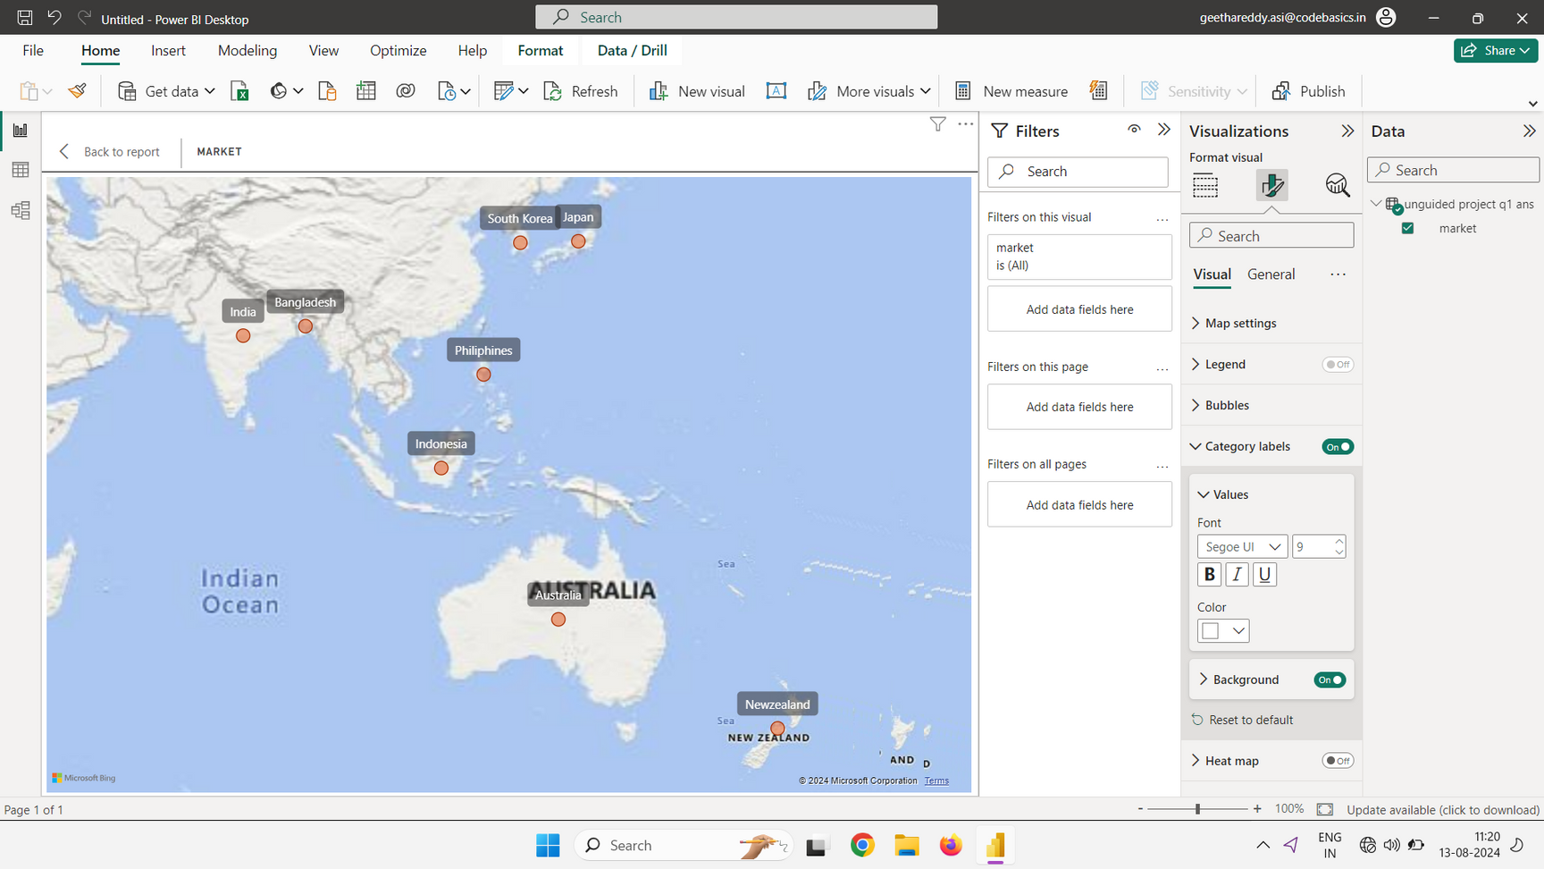


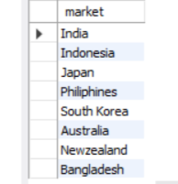

1
Provide the list of markets in which customer "AtliQ Exclusive" operates its business in the APAC region
Insights
The customer 'AtliQ Exclusive' operates its business across 8 countries in the APAC region

Slide 8
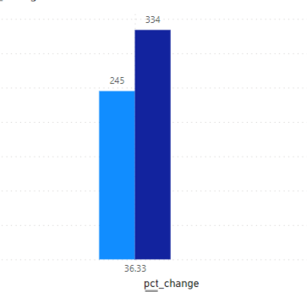

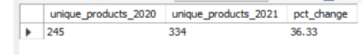

2
What is the percentage of unique product increases in 2021 vs. 2020? The final output contains these fields,
unique_products_2020
unique_products_2021
percentage_chg
Insights
There was a 36.33 % increase in unique products from 2020 to 2021. It highlighting a significant growth in product variety.

Slide 9
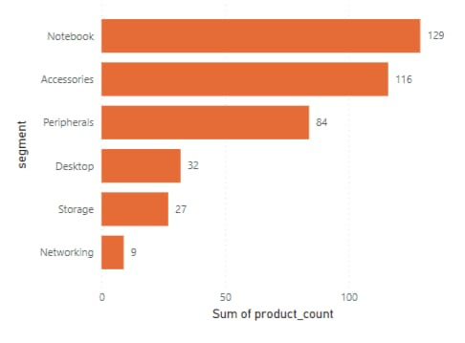
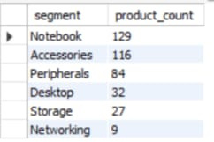


3
Provide a report with all the unique product counts for each segment and sort them in descending order of product counts.The final output contains 2 fields,
segment
product_count
Insights
It Shows that Notebook,Accessories are broad in terms of product offerings.
Peripherals might benefit from a review to determine if there's potential for expanding their product range
Desktop,Storage,Networking having lower product counts might need targeted efforts to enhance their product offerings

Slide 10

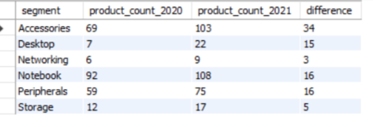
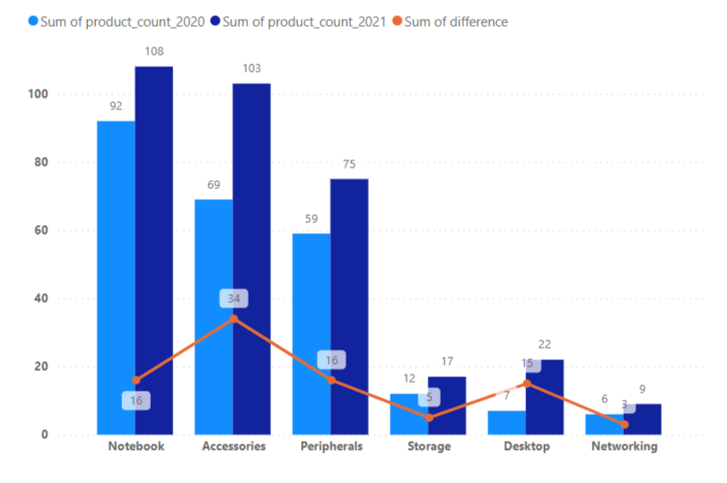

4
Which segment had the most increase in unique products in 2021 vs 2020? The final output contain these fields,
segment
product_count_2020
product_count_2021
difference
Insights
Accessories expereinced the most significant increase in unique products growing by 34 from 2020 to 2021. It indicates a Substantial enhancement in the segments product offerings

Slide 11
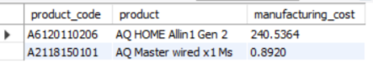

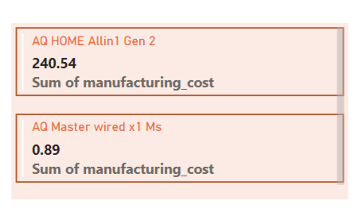

5
Get the products that have the highest and lowest manufacturing costs.The final output should contain these fields,
product_code
product
manufacturing_cost
Insights
The Product with highest manufacturing cost is AQ Home Allin 1 Gen 2 and lowset manufacturing cost is AQ Master wired x 1 Ms. This disparity indicates a significant range in product costs across our product line

Slide 12


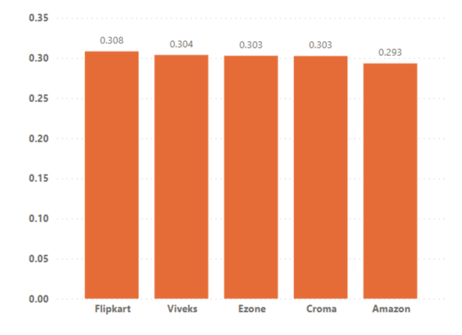
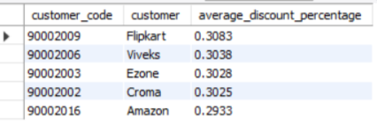

6
Generate a report which contains the top 5 customers who received an average high pre_invoice_discount_pct for the fiscal year 2021 and in the indian market . The final output contains these fields,
customer_code
customer
average_discount_percentage
Insights
The top 5 customers in the indian market for the fiscal year 2021 received an average discount percentage range from 0.29% to 0.30% Flipkart received highest average discount indicating they might have a strong negotiating position or represnt a significant volume of business

Slide 13
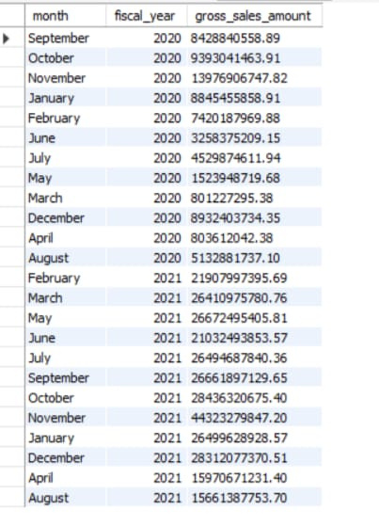
7
Get the complete report of the Gross sales amount for the customer "AtliQ Exclusive" for each month . This analysis helps to get an idea of low and high-performing months and take strategic decisions. The final report contains these columns:
month
year
gross sales month

Slide 14
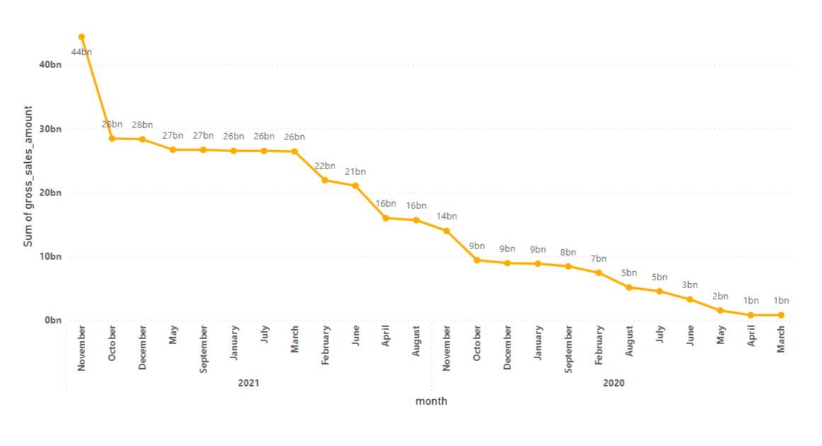

7
Get the complete report of the Gross sales amount for the customer "AtliQ Exclusive" for each month . This analysis helps to get an idea of low and high-performing months and take strategic decisions. The final report contains these columns:
month
year
gross sales month
Insights
The month with the highest gross sales amount for 'Atliq Exclusive' is November 2021, because many economies were beginning to recover from the initial impact of the pandemic.
march 2020 had the lowest gross sales amount, because the global economic impact of the pandemic was severe in early 2020 causing economic downturns, decreased consumer spending which could explain the lower sales

Slide 15

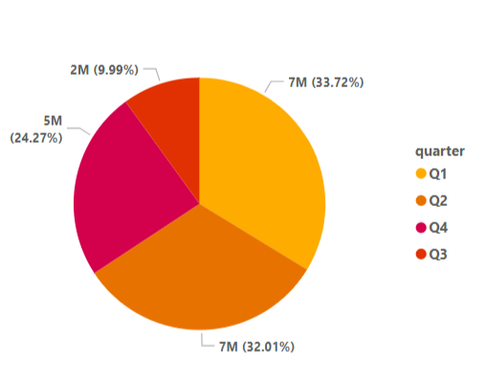


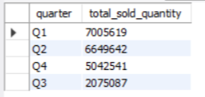
8
In which quarter of 2020,got the maximum total_sold_quantity? The final output contains these fields sorted by the total_sold_quantity,
Quarter
total_sold_quantity
Insights
The first quarter (Q1) expereinced the highest sold quantity . It suggests that beginning of the year had the strongest sales performance .
The third quarter (Q3) had the lowest sold quantity.
The sales for Q2 and Q4 are relatively close but still show a decrease compared to Q1 .

Slide 16

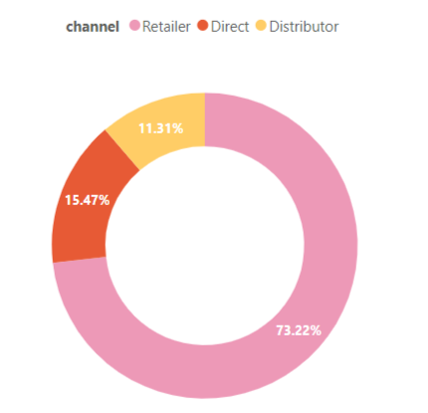
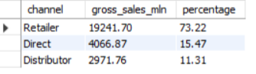
7
9
Which channel helped to bring more gross sales in the fiscal year 2021 and the percentage of contribution ? The final output contains these fields,
channel
gross_sales_mln
percentage
Insights
Retailer was the most successful in generating gross sales with 73% for the fiscal year 2021. It suggest that it is a key driver of revenue and it should be prioritized for further investment and optimization.
Direct channel contribute 15% of the total gross sales and distributor contributes 11% of the total gross sales. It is not a major revenue driver, it could still be optimized for better revenue performance

Slide 17



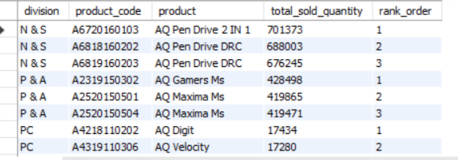


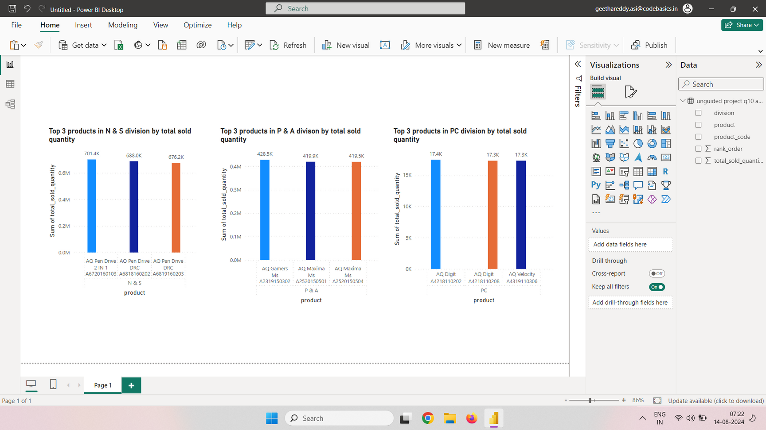
10
Get the top 3 products in each divison that have a high_total_sold_quantity in the fiscal_year 2021? The final output contain these fields,
divison
product_code
product
total_sold_quantity
rank_order
Insights
Pen Drive is the standout performer in N & S divison
AQ Gamers is the standout performer in P & A divison
AQ digit the standout performer in PC division

Slide 18




Focus on high performing products
Enhance customer engagement
For low cost products with high demand,explore ways to increase production efficiency and maximize profitability
Strengthen relationship with these top customers through targeted promotions and personalized enagement
Suggestions
Channel performance enhancement
Monthly Sales Monitoring
Develop targeted marketing and sales strategies to boost performance during low performing months and capitalize on peak periods
Increase investment and support for the leading sales channel. Explore successful tactics used by the channel and apply them to other channels to improve their performance

